Slide 1
Training
INTERNSHIP STUDIO
Shivam Kumar
Internship at "INTERNSHIP STUDIO"
OFFERED BY : NATIONAL ENGINEERING OLYMPIAD
SUBJECT : ETHICAL HACKING

Slide 2
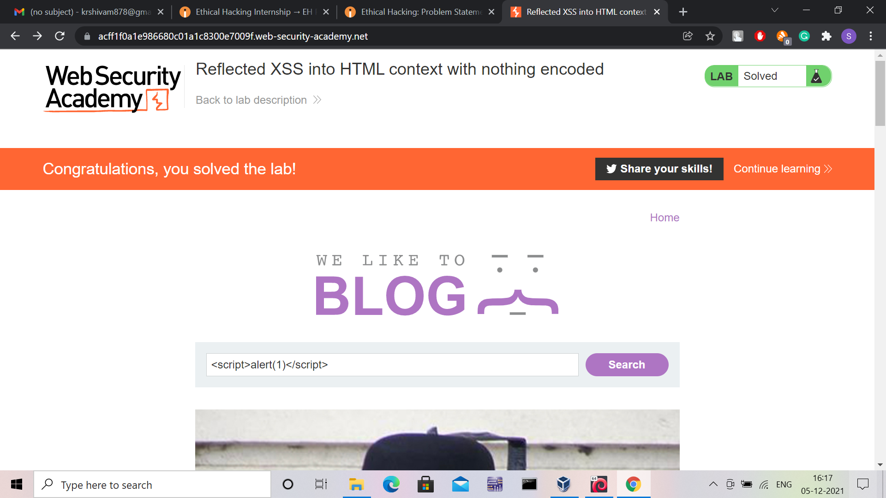
TASK 1 – LAB 1

Slide 3
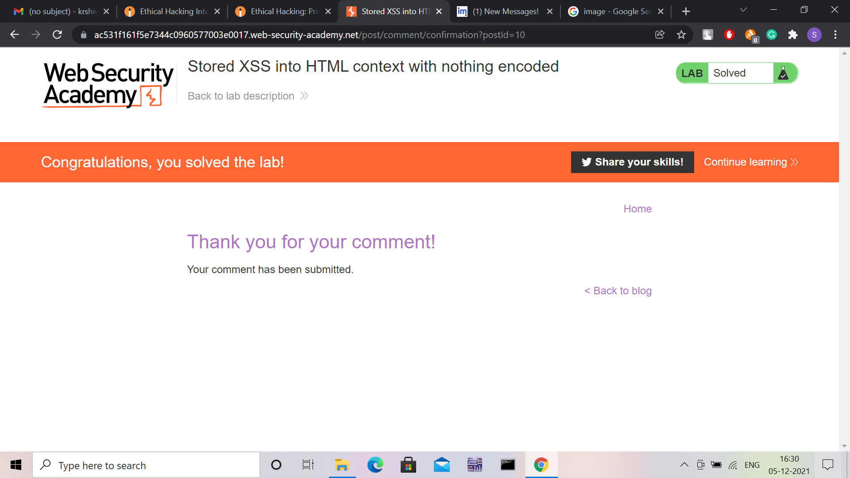
TASK 2 – LAB 2

Slide 4
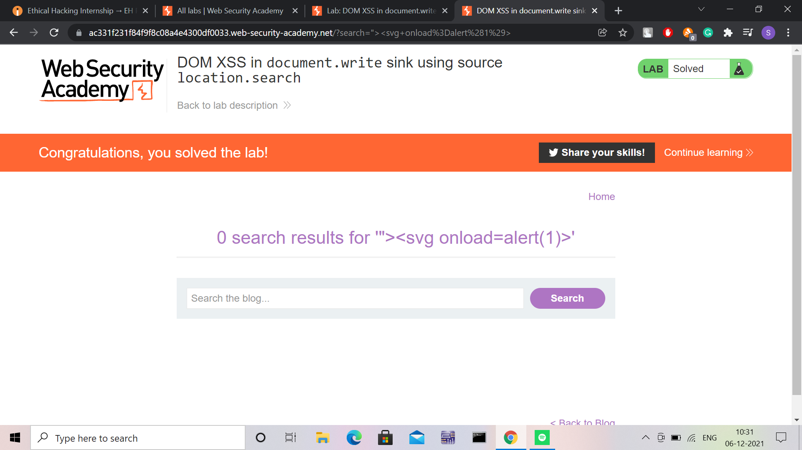
TASK 1 – LAB 3

Slide 5
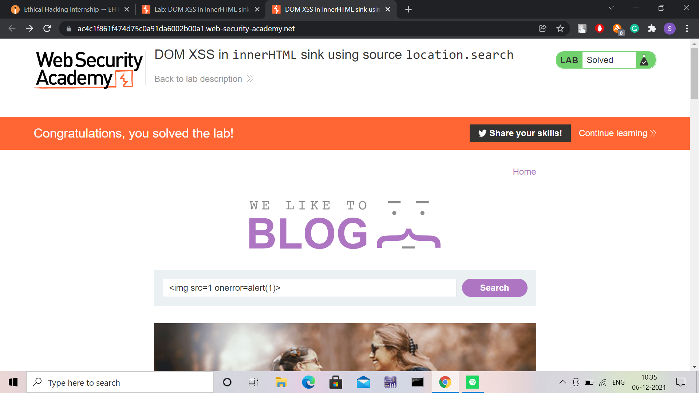
TASK 1 – LAB 4

Slide 6
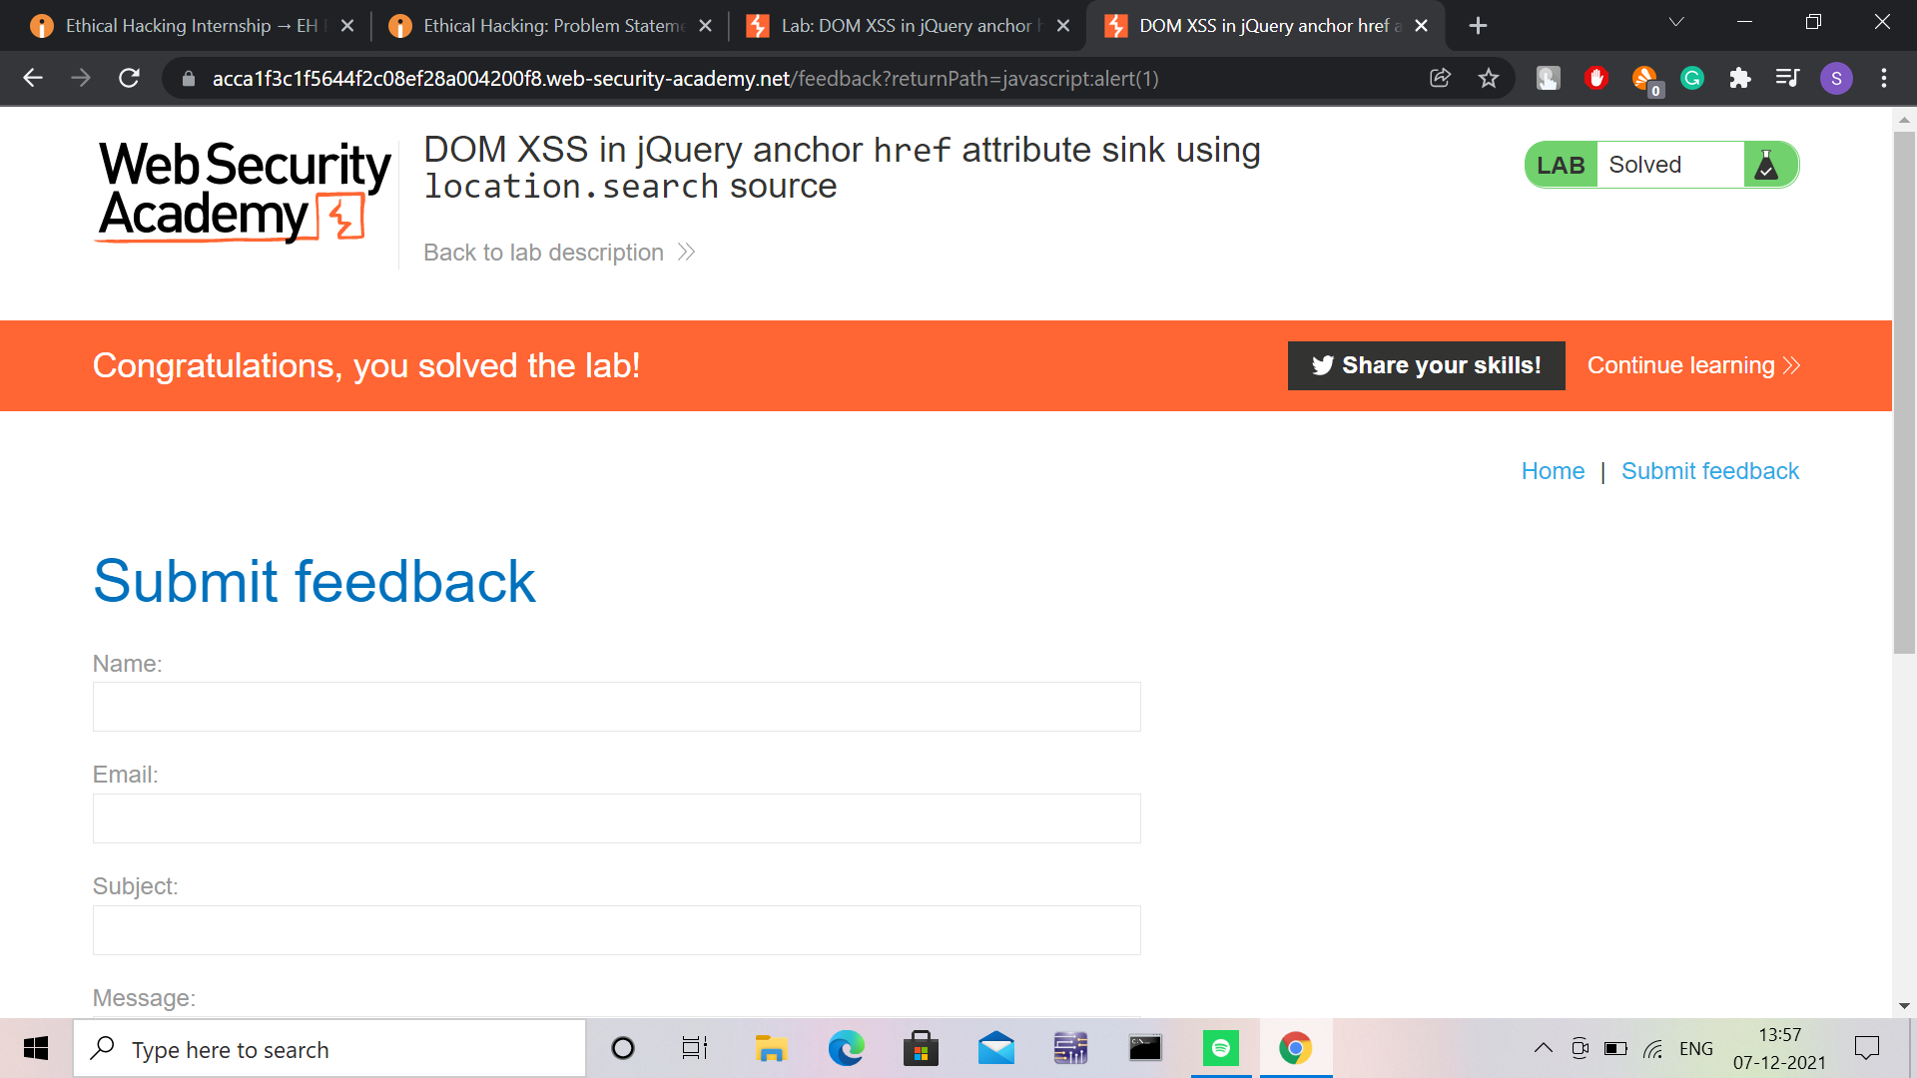
TASK 1 – LAB 5

Slide 7
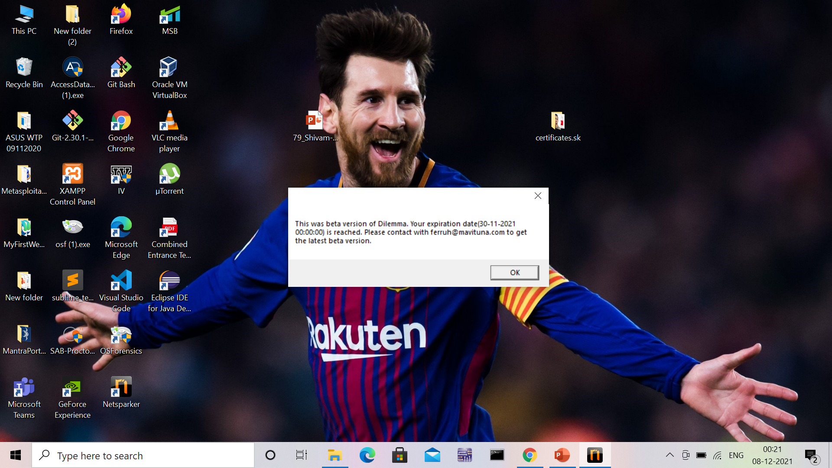
TASK 2 : USING NETSPARKER

Slide 8
TASK 3 VULNERABILITIES IN http://testasp.vulnweb.com/

Slide 9
REPORT ON VULNERABILITIES IN "testasp.vulnweb.com"
GOOGLE DRIVE LINK ::
https://drive.google.com/file/d/1rux1njpOu-pdklIX4GcFGRqiQMyPnePb/view?usp=sharing

Slide 10
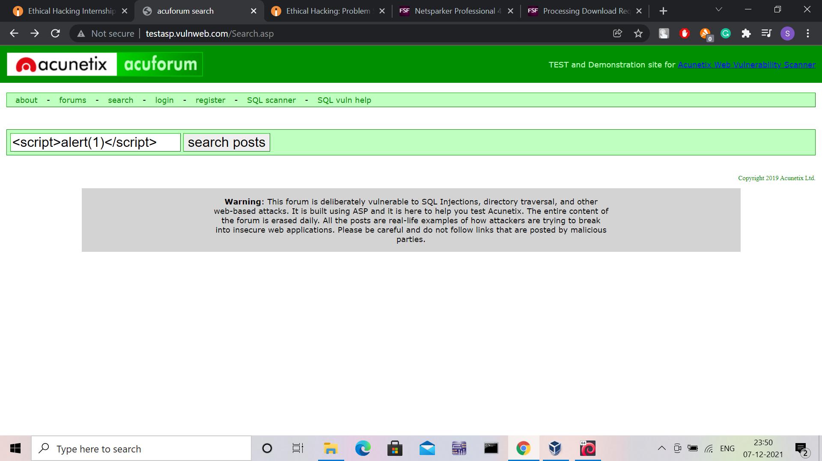
TASK 3 : 1st

Slide 11
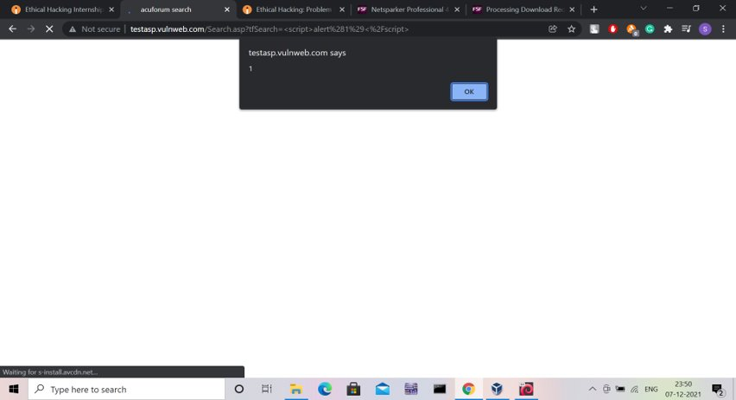
TASK 3 : 1st

Slide 12
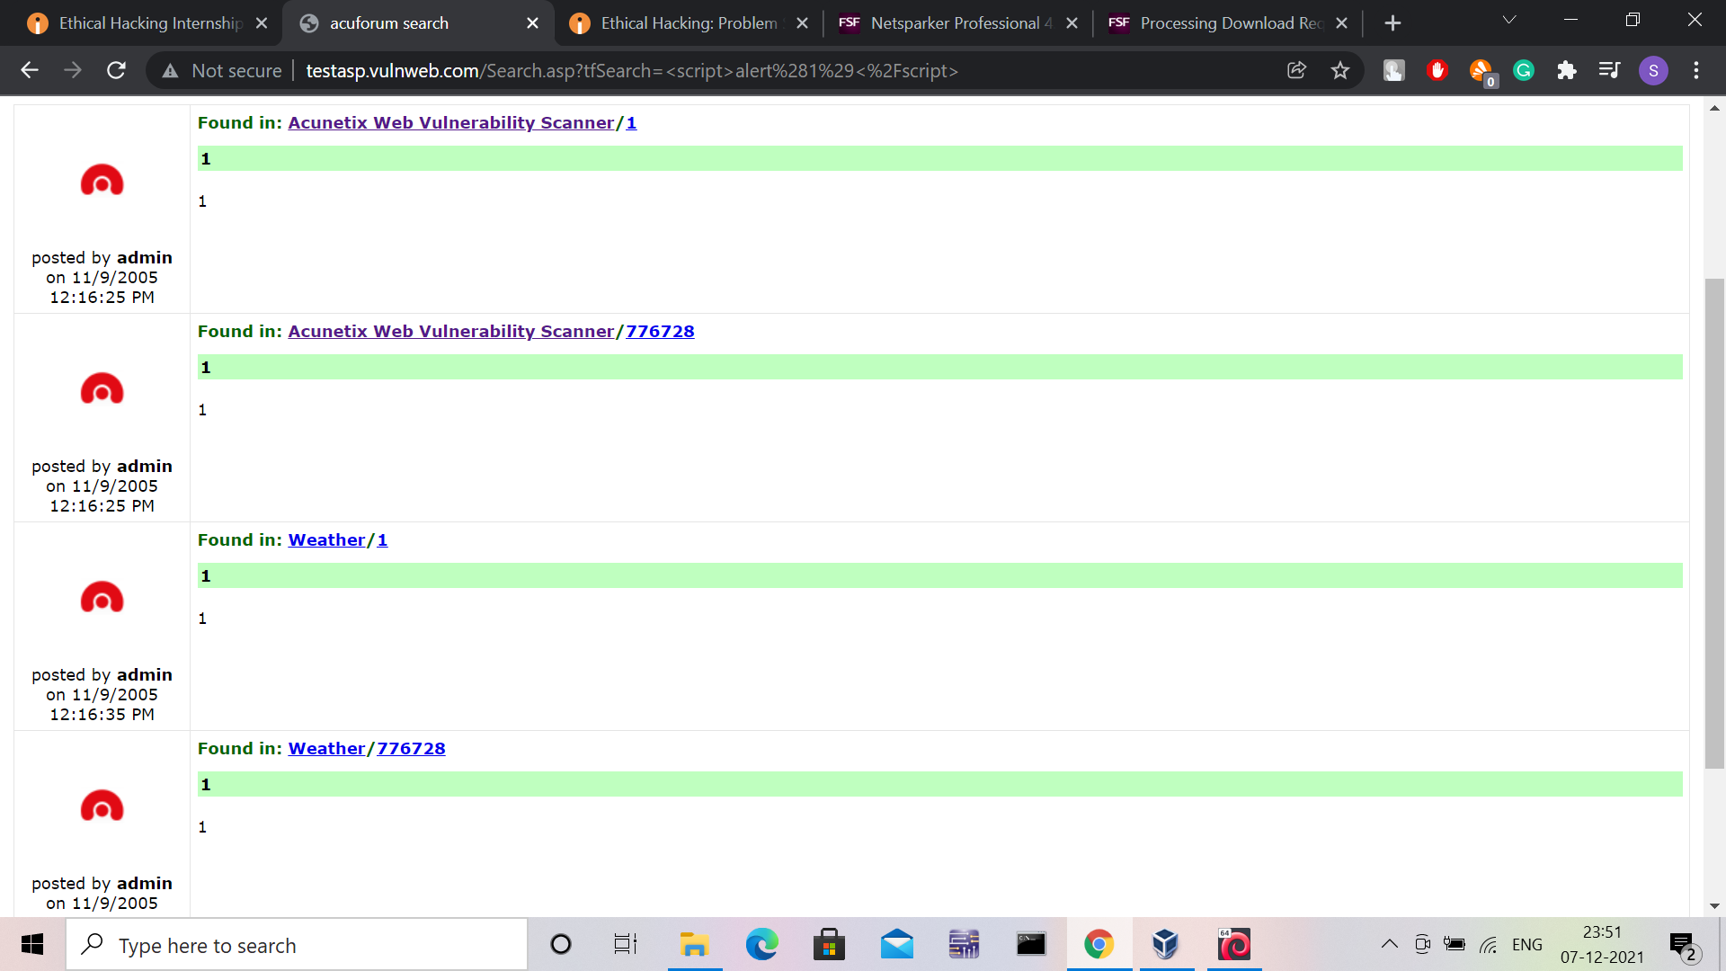
TASK 3 : 1st

Slide 13
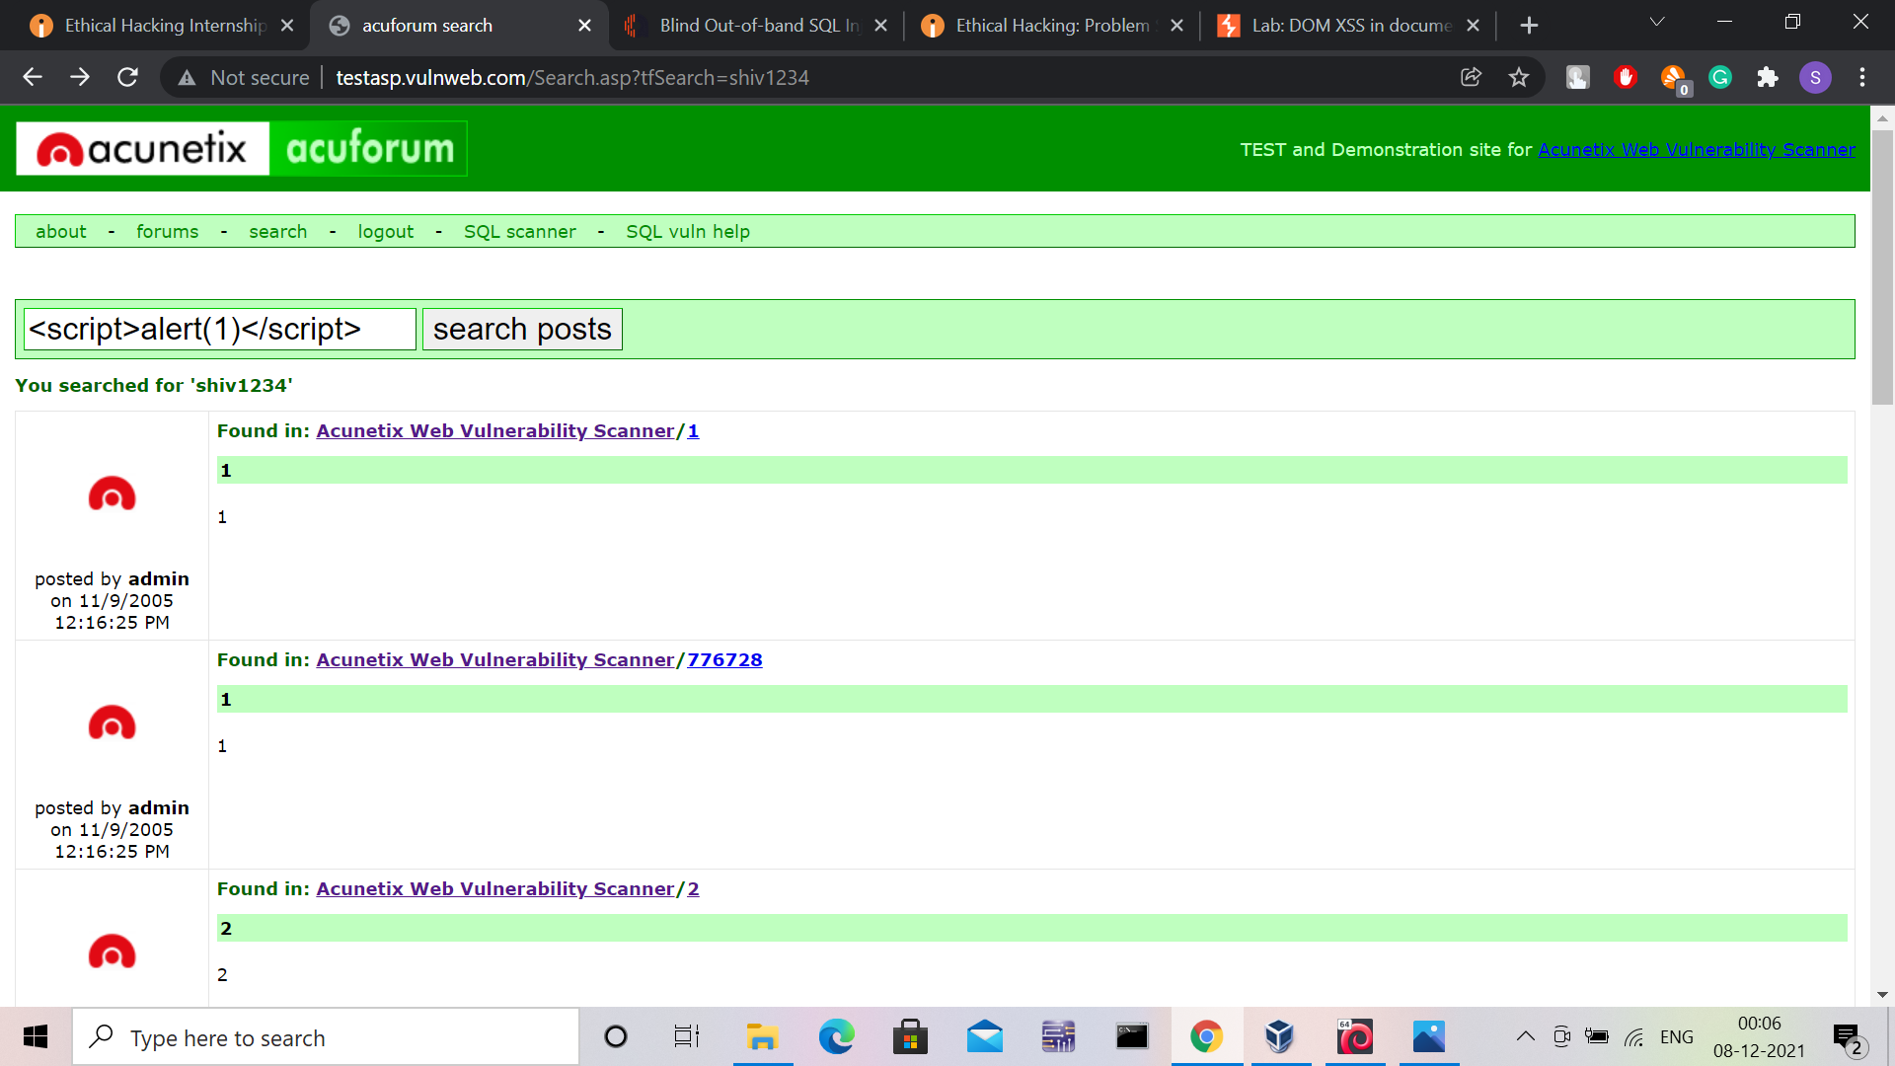
TASK 3 : 2nd

Slide 14
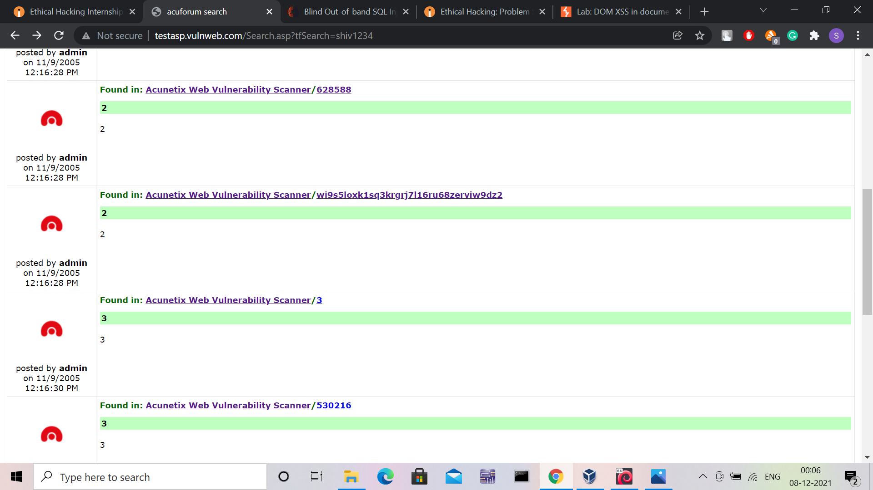
TASK 3 : 2nd

Slide 15
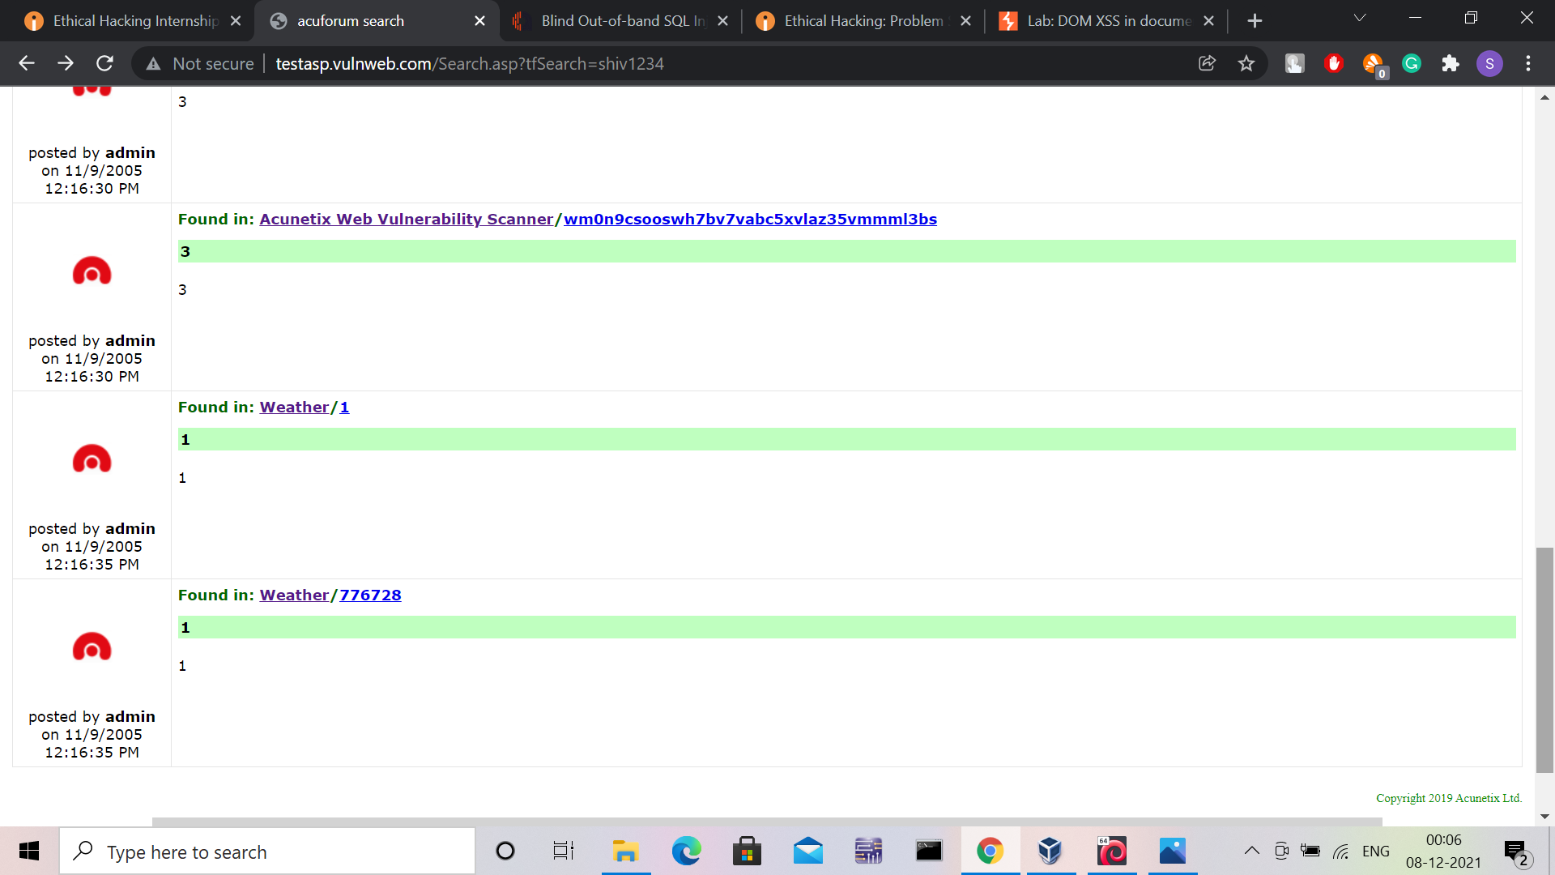
TASK 3 : 2nd

Slide 16
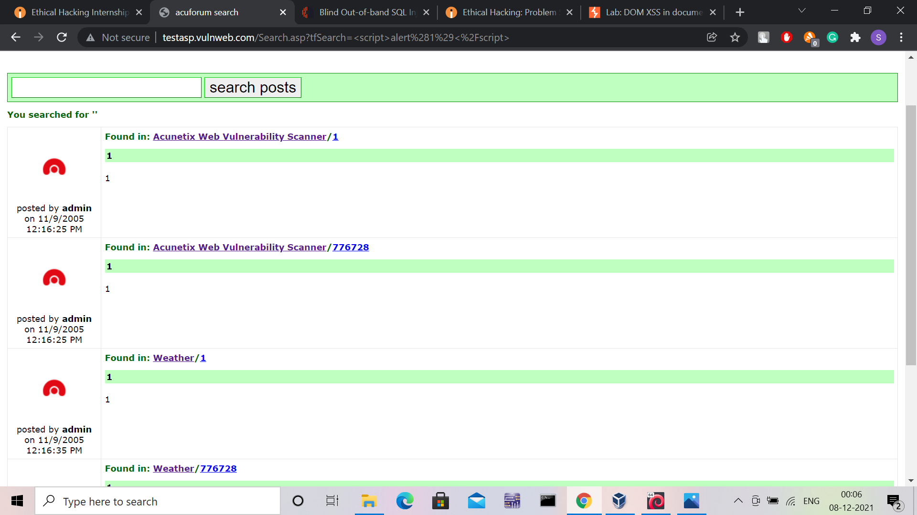
TASK 3 : 2nd

Slide 17
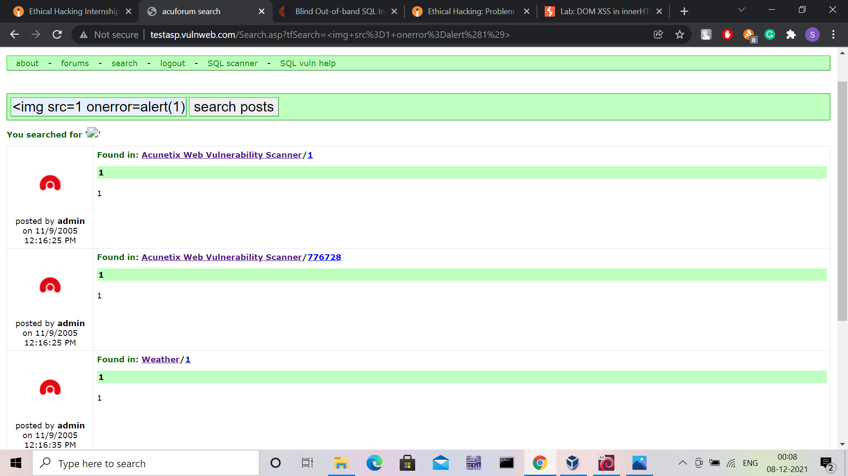
TASK 3 : 3rd

Slide 18
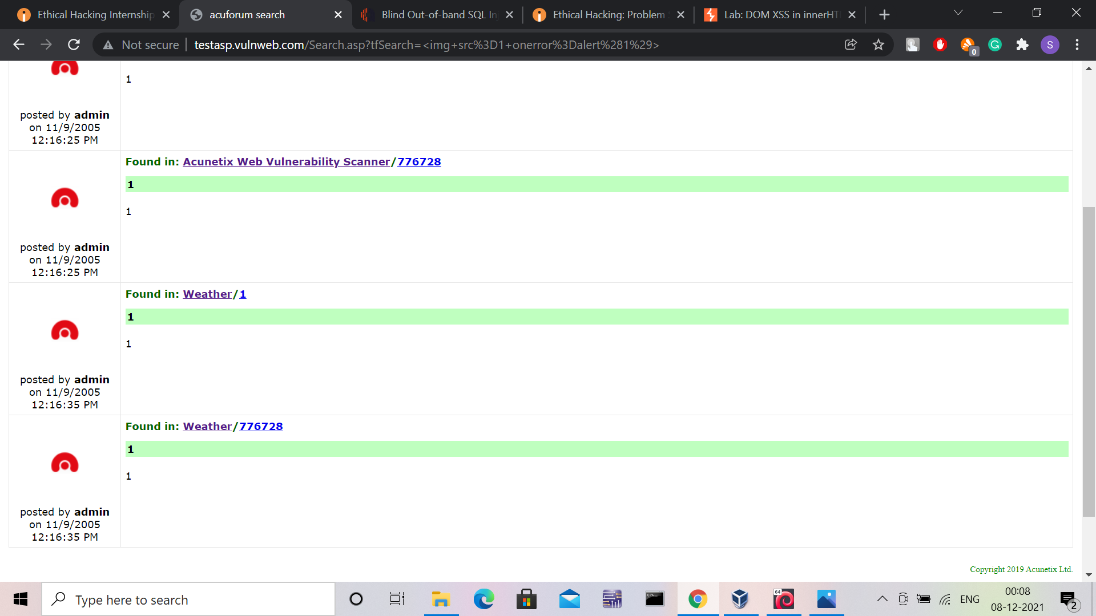
TASK 3 : 3rd

Slide 19
Thank You

